Slide 1
$match

Slide 2
$match
$match filters documents from the previous stage of the pipeline.
It can occur anywhere, though it’s more efficient to add it early when possible
It has the same syntax as the find command filter syntax

Slide 3
High level syntax
{$match:{filter conditions}}

Slide 4
High level syntax
{$match:{attribute:{operator:value}}}

Slide 5
High level syntax
{$match:{$and:[{attribute:{operator:value}},
{attribute:{operator:value}}]}

Slide 6
High level syntax
{$match:{$or:[{attribute:{operator:value}},
{attribute:{operator:value}}]}

Slide 7
Operators
Operator | Description
$eq | Matches values that are equal to a specified value.
$gt | Matches values that are greater than a specified value.
$gte | Matches values that are greater than or equal to a specified value.
$in | Matches any of the values specified in an array.
$lt | Matches values that are less than a specified value.
$lte | Matches values that are less than or equal to a specified value.
$ne | Matches all values that are not equal to a specified value.
$nin | Matches none of the values specified in an array.

Slide 8
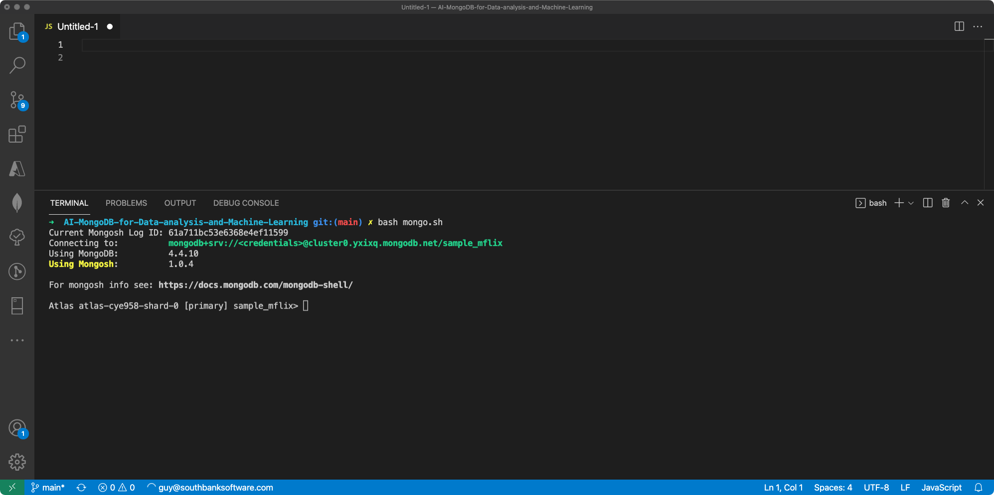

Slide 9
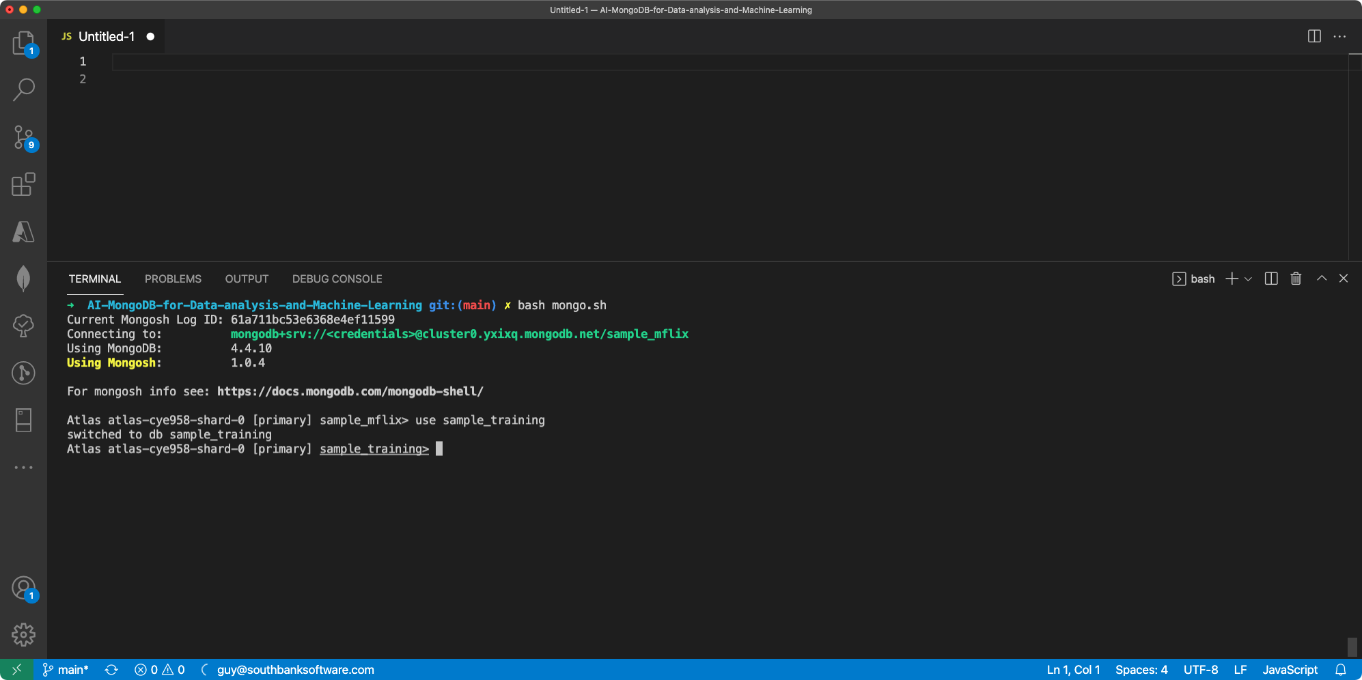

Slide 10
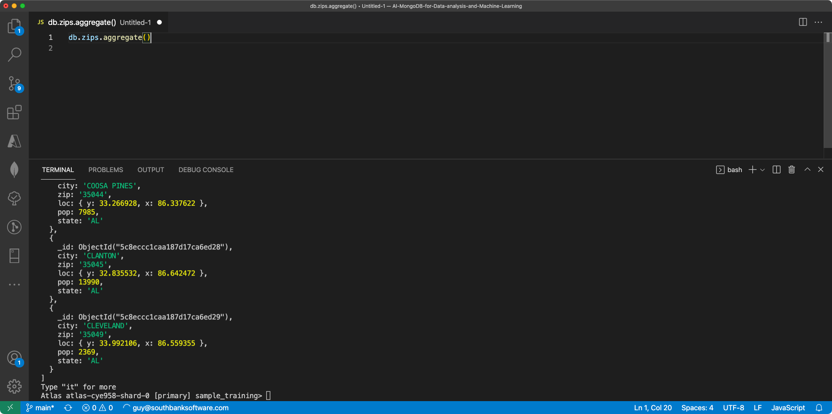

Slide 11
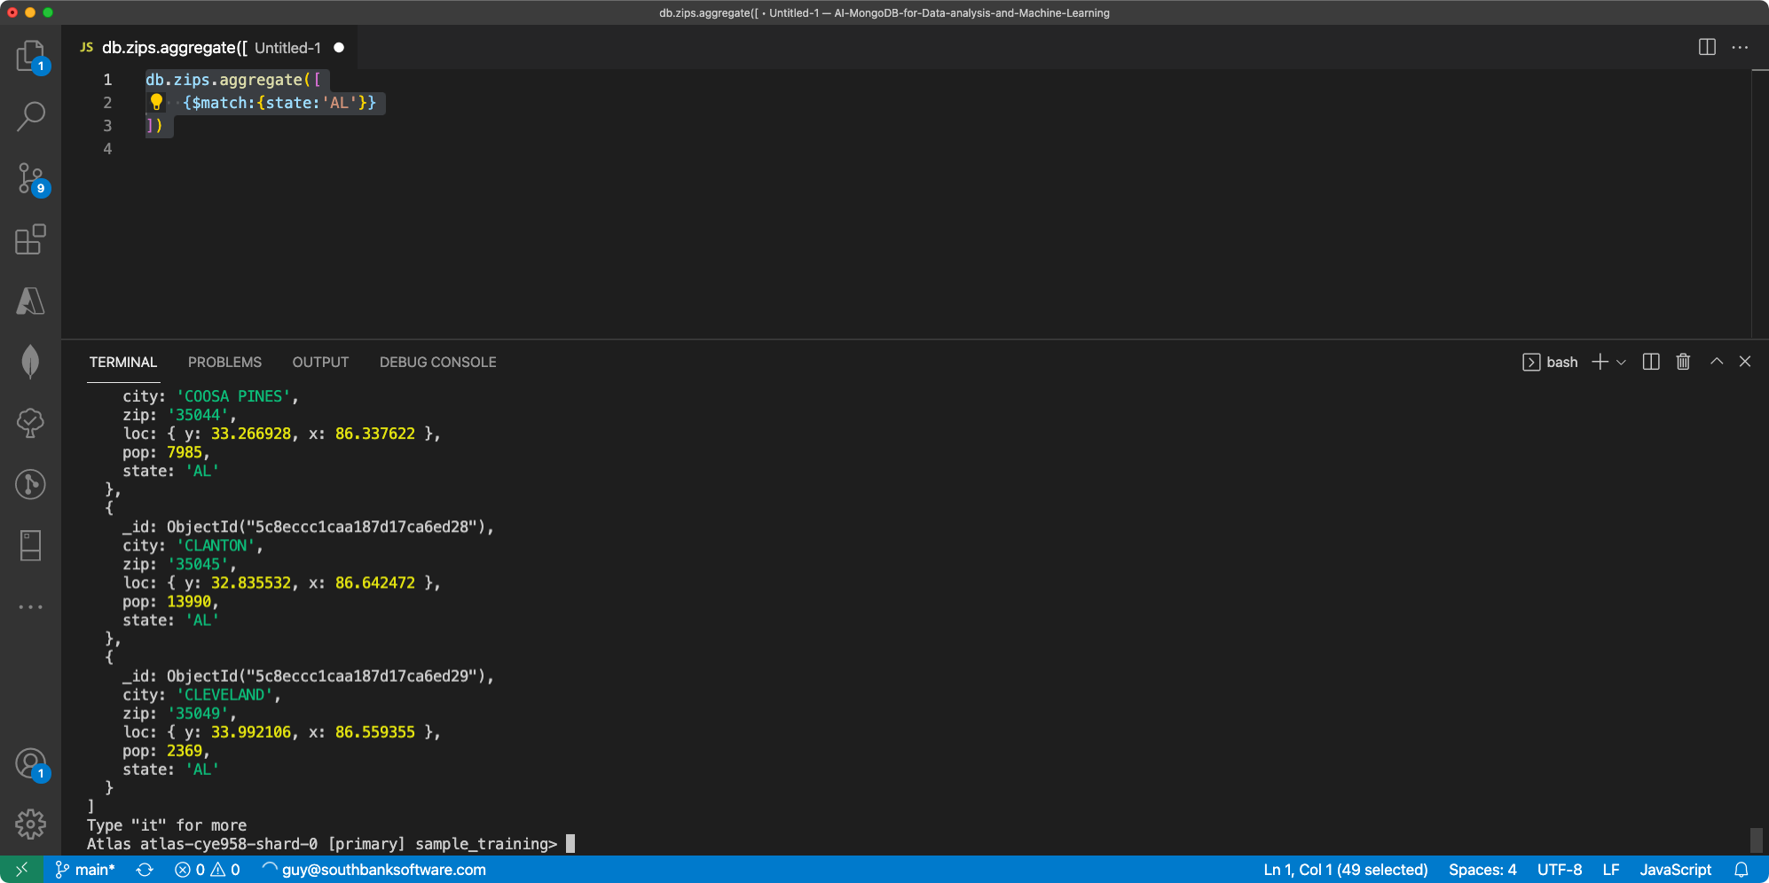

Slide 12
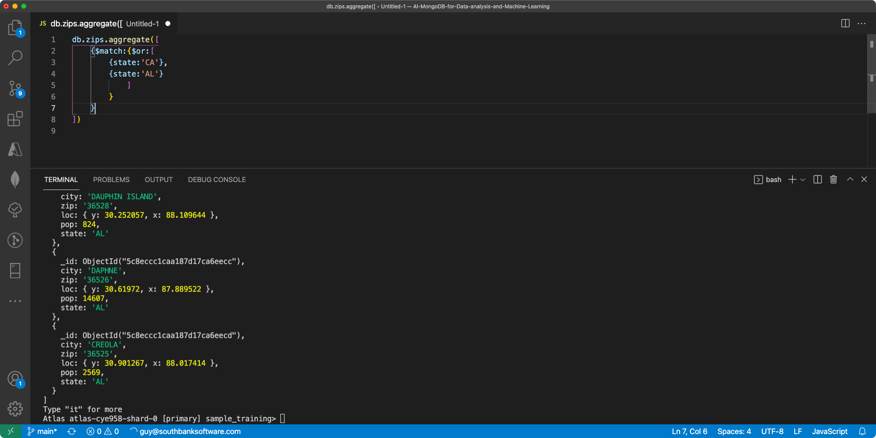

Slide 13
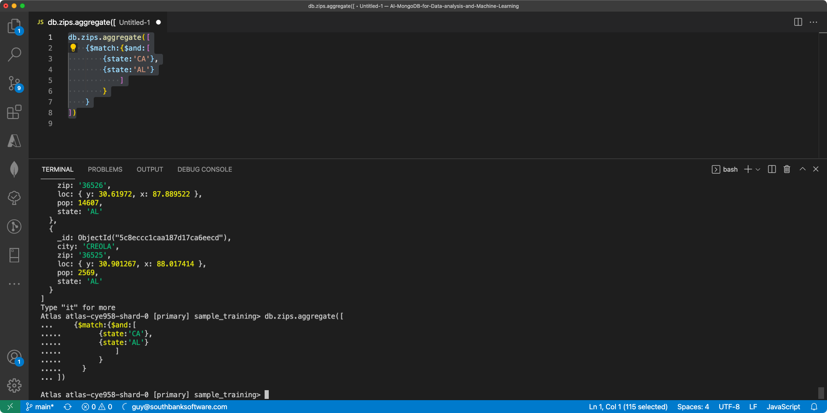

Slide 14
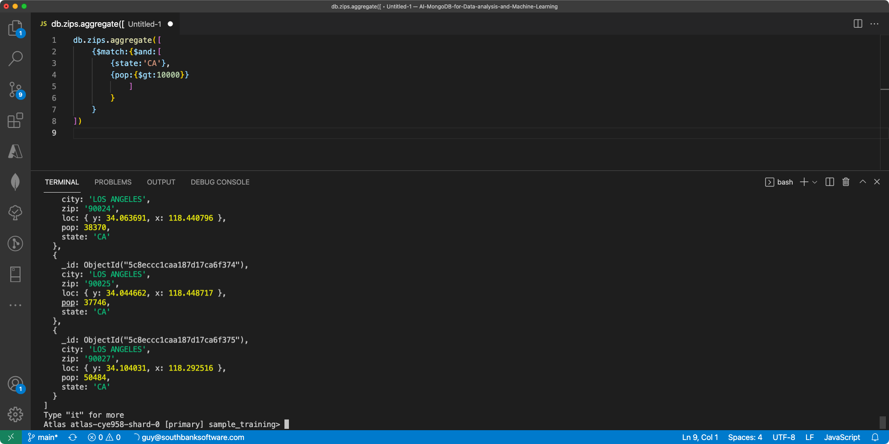

Slide 22
Why do they call it a pipeline?
Aggregation commands are added one at a time to provide a “pipeline” of processing
Collection
Filter
Group
Sort
Results

Slide 23
High level syntax
db.collection.aggregate();

Slide 24
High level syntax
db.collection.aggregate([
{stage},
{stage},
{stage}
]);

